Slide 1


Slide 2
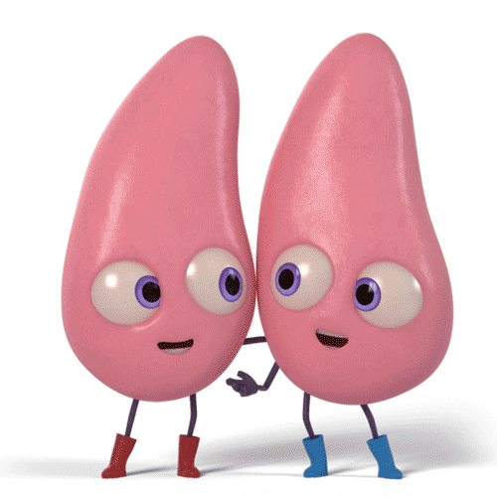
Pneumonia
By Prof.
Olfat Mostafa El-Shinnawy

Slide 3
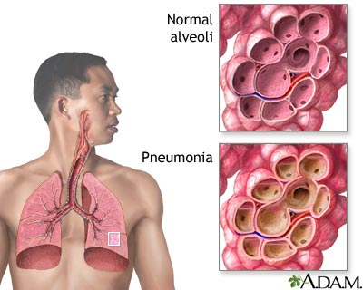
Pneumonia
Definition:
An inflammation, in general acute, of the lung substance, leading to consolidation of a part or the whole lung due to intra-alveolar exudation.

Slide 4
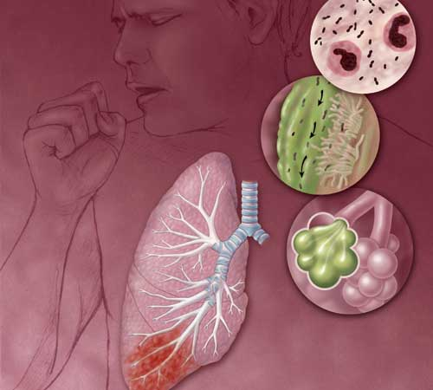

Slide 5
Pneumonia, a leading cause of death all over the world, it is an infection of the lung parenchyma, most common types and Causes include::
Community acquired pneumonia(CAP)
  S. pneumoniae (most common cause)
  Subsequent causes may vary, but S. pneumoniae is always number 1
Hospital acquired pneumonia(HAP)
  Gram-negative bacilli such as E. coli, the other Enterobacteriaceae, or Pseudomonas
  MRSA

Slide 6
Community Acquired Pneumonia (CAP)
Community- acquired pneumonia (CAP) refers to pneumonia acquired outside of hospitals or extended- care facilities.
Internationally CAP is common problem both for community & hospital physicians. It occurs with an annual incidence of about 5-11 per 1000 adult population & rises with age to about 34 per 1000 population for patients aged over 75 years

Slide 7
The annual incidence of patients that require hospital admission varies from approximately 1-4 per 100000 population
The morality rate are low (<1%) for patients managed in the community, higher in patients admitted to hospital around 5-12% and highest for patients requiring mechanical ventilation with rates from around 35% to 50%
It is thus a common disease & can have a considerable impact on health care resources

Slide 8
Community acquired pneumonia(CAP)
Causes include:
 | “Typical”
15-35% | Strep. pneumoniae
2-10% | Haemophilus
5% | Moraxella
 | “Atypical”
0-15% | Legionella
10% | Mycoplasma
5-10% | Chlamydia
2-20% | Viral
30-60% | Unknown

Slide 9
Specific predispositions are as follows:
  Cigarette smoking,
  Diabetes,
  Alcoholism,
  Malnutrition,
  Obstruction of the bronchi from tumors,
  Immunosuppression in general

Slide 10
Clinical Presentation
Patients with pneumonia present with cough, fever, and often sputum production. Severe pneumonia of any cause may present with dyspnea.
The quality and degree of sputum produced might provide useful clues to the microbiologic etiology of pneumonia at the initial presentation.
Bacterial infections such as S. pneumoniae, Haemophilus, and Klebsiella have significant purulent sputum production because they are infections of the alveolar air space.

Slide 11
The sputum with S. pneumoniae is described as rusty. The “rust” is simply hemoptysis. As the blood oxidizes, it becomes brownish-red color
Interstitial infections such as those caused by viruses, Mycoplasma, and sometimes Legionella often give a non-productive or “dry” cough.

Slide 12
Any cause of pneumonia may be associated with pleuritic chest pain. This is pain worsened by inspiration.
Commonly, pleuritic pain is associated with lobar pneumonia, such as that caused by Pneumococcus. This is because of localized inflammation of the pleura by the infection.
Lobar pneumonia is the type most commonly associated with signs of consolidation on examination.

Slide 13
On physical examination pneumonia presents with :
  Inspection: ↓ movement sudden breath catch
  Palpation:
    ↑ T.V.F.
    Central mediastinum
    Palpable friction rub
  Percussion:
    Impaired note → dull note
  Auscultation:
    Bronchial breathing “high pitch”
    ↑ Whispering & ↑ vocal resonance
    Crepitations (medium sized, late inspiratory).
    Pleural rub

Slide 14
Diagnosis:
I-Chest x-ray is The most important initial test for pneumonia, which both shows the presence of disease and gives the initial clues to determining the diagnosis.
Infiltrates are either
  localized to a single lobe or the whole lung
  bilateral and interstitial
It is the most important clue.

Slide 15
S. pneumoniae (and other causes of “typical” pneumonia) usually appear as a lobar pneumonia, sometimes with parapneumonic pleural effusion.
Interstitial infiltrates are associated with viral, Mycoplasma, Chlamydia, Coxiella, and sometimes Legionella pneumoniae.

Slide 16
II. Hematology:
  Neutrophil leucocytosis is usual in pneumococcal pneumonia & other bacterial pneumonias. The total white blood cell count doesn't often exceed 30,000 & is more frequently 12,000 – 15,000/mm³
  Lymphopenia in legionella & viral pneumonia
  Sometimes there is eosinphilia in convalescence
  Normocytic anemia commonly seen in severe pneumonia.
  The erythrocyte sedimentation rate is usually raised & may be very high, a rate of 100mm or more isn't uncommon. It decreases in convalescence.
  Increased Inflammatory markers as c-reactive protein
  Raised procalcitonin level in bacterial infection

Slide 17
III-Sputum sample should be obtained for both Gram stain as well as culture. Sputum culture is the most specific diagnostic test for lobar pneumonia, such as with S. pneumoniae, Staphylococcus, Klebsiella, and Haemophilus.
The other “atypical” organisms (viral, Mycoplasma, Chlamydia, Coxiella, etc.) will not show up on Gram stain or regular bacterial culture for various reasons, so serology must be done to detect them.

Slide 18
The diagnosis of CAP require :
(1)Basic finding a new pulmonary infiltrate seen on a chest radiograph that is obtained within 24 h of presentation;
(2) at least one of
cough, sputum production, or temperature≥37.8°C.
or at least two of ,
pleuritic chest pain, dyspnea,
altered mental status,
pulmonary consolidation, and WBC ≥ 12,000 cells/L.
the major criteria
the minor criteria

Slide 19
Treatment of CAP
General lines
Antibiotic therapy

Slide 20
General lines:
Treatment of predisposing factors
Bed rest & proper nursing; easily digested food & excess Fluid
Cough sedatives early; then expectorants
Supportive measures : vitamin A, B & C
Analgesics to control pleurtic pain.
Oxygen therapy.

Slide 21
Antibiotic therapy for CAP should:
Started empirically
Selected with patients characteristics, place of acquisition and severity of the disease
When specific pathogen is identified ; specific antibiotic could be used

Slide 22
Empiric Therapy of Community-Acquired Pneumonia
Outpatient treatment
Young, healthy patients with no comorbidities or antibiotic use in preceding 3 months:
  Azithromycin, clarithromycin, or doxycycline
With comorbidities, or antibiotic use in preceding 3 months use either
  Respiratory fluoroquinolones (Levofloxacin, moxifloxacin)
  or oral beta-lactam (Oral second- and third-generation cephalosporins or amoxicillin/clavulanate) + a macrolide or doxycycline

Slide 23
Hospitalized patients
Respiratory fluoroquinolones (levofloxacin, or moxifloxacin,)
Or
Second- or third-generation cephalosporins (cefuroxime or ceftriaxone) combined with a macrolide or doxycycline
Or
Beta-lactam/beta-lactamase combination drug (ampicillin/sulbactam; ticarcillin/ clavulanate; piperacillin/tazobactam) combined with doxycycline or a macrolide

Slide 24
If risk factors for Community acquired -MRSA, use above therapy + vancomycin or linezolid or ceftaroline + a macrolide or doxycycline
If risk factors for Pseudomonas, use antipseudomonal beta-lactam (like cefepime or meropenem) + ciprofloxacin; for penicillin-allergy, use a respiratory quinolone + aztreonam

Slide 25
Duration of therapy
Patients with CAP should be treated with antibiotics for a minimum of 5 days ,however 7-10 days is usually adequate
Should be afebrile for 3-4 days and have no more than one CAP-associated sign of clinical instability prior to discontinuation.

Slide 26
Patients who have been hospitalized and are receiving intravenous antibiotics should be switched to oral therapy as soon as they are
  hemodynamically stable,
  improving clinically,
  able to ingest medications, and
  have normal digestion

Slide 27
Chest x-ray should be done every week
Usually the x-ray film return to normal within 2-6 weeks however in old age patients ;it may take longer duration
If resolution delayed we must search for underlying cause

Slide 28
Causes of delayed resolving pneumonia:
1- inadequate ttt (type, dose, or time)
2-Specific pathogen,eg;TB
3-Underlying pathology(neoplasia, foreign body, bronchiectesis)
4-Empyema
5-Immunocompromised: DM, CHF, alcoholism,etc.

Slide 29
Hospital acquired pneumonia

Slide 30
The 2016 Infectious Diseases Society of America
(IDSA)/American Thoracic Society (ATS) guidelines distinguish the following types of pneumonia:
●Hospital-acquired (or nosocomial) pneumonia (HAP) is pneumonia that occurs 48 hours or more after admission and did not appear to be incubating at the time of admission.
●Ventilator-associated pneumonia (VAP) is a type of HAP that develops more than 48 to 72 hours after endotracheal intubation.

Slide 31
Treatment of HAP

Slide 32
Regardless of severity, the initial empirical treatment regimens for HAP who have early-onset HAP (within 4 to 5 days of hospitalization) should include coverage for a group of core organisms that includes
  Antibiotic-sensitive, aerobic, enteric gram-negative bacilli (e.g., E. coli, Klebsiella spp., Proteus spp., and Serratia marcescens),
  community pathogens such as Haemophilus influenzae
  Streptococcus pneumoniae, as well as methicillin-sensitive S. aureus

Slide 33
Early onset HAP Treatment
Extended spectrum cephalosporin
Or
B-lactam+b-lactamase inhibitor
Or
fluoroquinolones

Slide 34
Those patients who develop pneumonia late-onset after 5–7 days in the hospital are at increased risk of infection from:
  drug-resistant, gram-negative bacilli (Pseudomonas, Klebsiella, E. coli, Acinetobacter spp..) or gram-positive bacilli such as MRSA.

Slide 35
Third-generation cephalosporin with antipseudomonal activity (e.g., ceftazidime) or carbapenem (e.g., imipenem)
Beta-lactam/beta-lactamase inhibitor combinations (such as piperacillin/tazobactam) plus an antipseudomonal fluoroquinolone (e.g., ciprofloxacin) and vancomycin or linezolid to cover MRSA.
Possible addition of polymyxin(colistin) or an aminoglycoside (gentamicin, tobramycin, amikacin) to empiric gram-negative coverage

Slide 36
Pneumonia is a wild monster as even with modern medical care the case mortality is about 12%.
Prevention through Smoking cessation, Pneumococcal & Influenza vaccination must be the main goal in pneumonia management
Early antibiotic administration within 4-6 hours
Empiric antibiotic treatment as per guidelines (IDSA / ATS) must be given
Typical and Atypical pathogens must be considered in the choice of antibiotic therapy.

Slide 37


